Slide 1
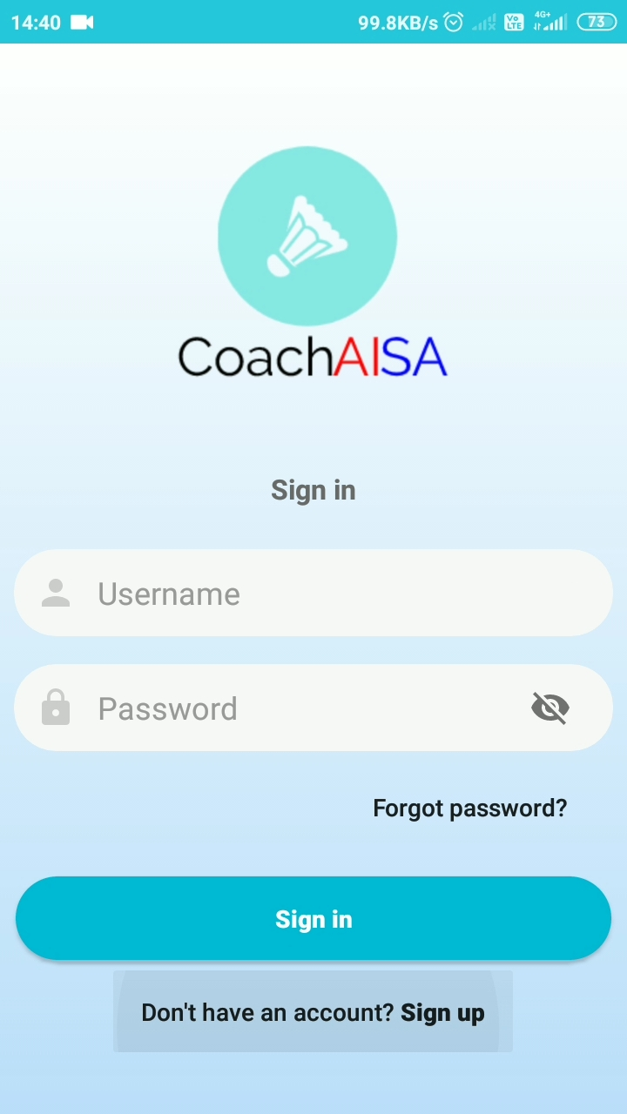
Login
If the user is new, register by tapping on “Don’t have an account? Sign Up” which will redirect to the SIGN UP page. Else enter the registered E-mail ID and associated password to sign in to the app.

Slide 2
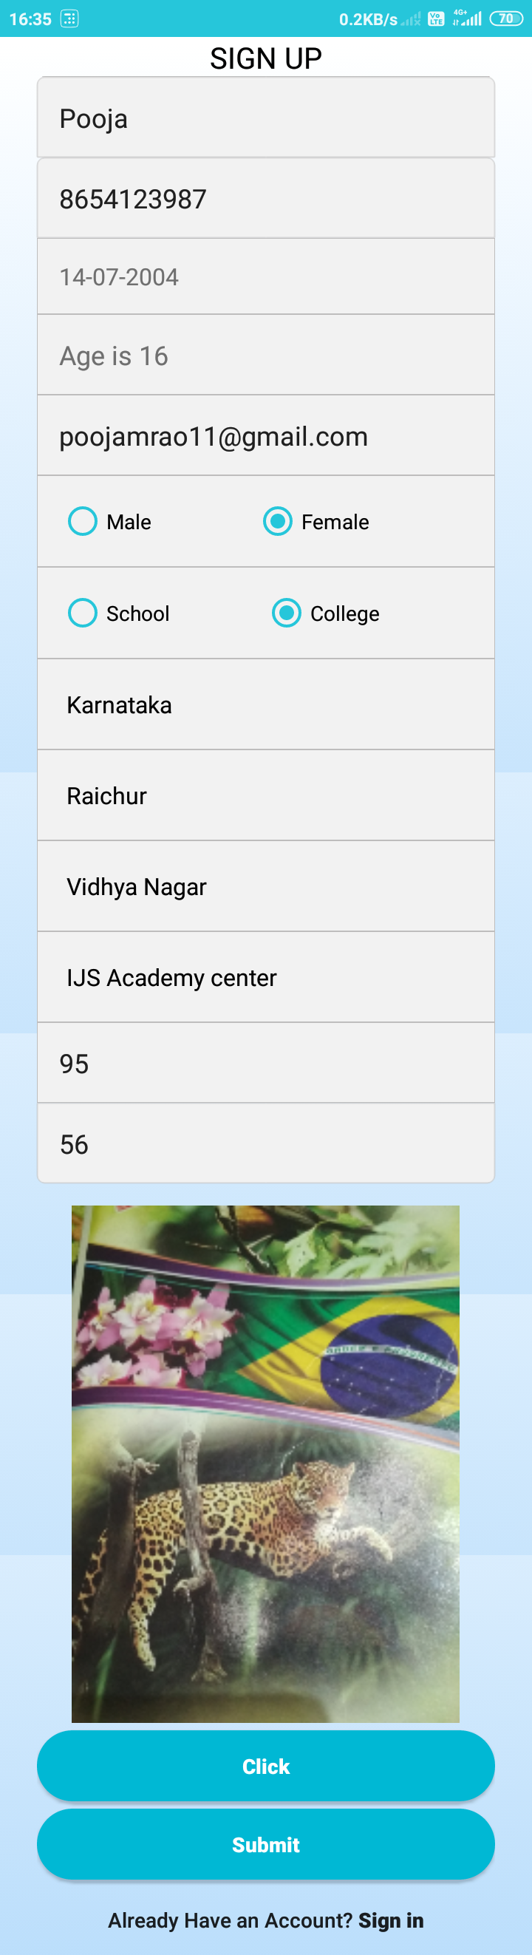
Registration
Enter the proper details.
1. Name

Slide 3
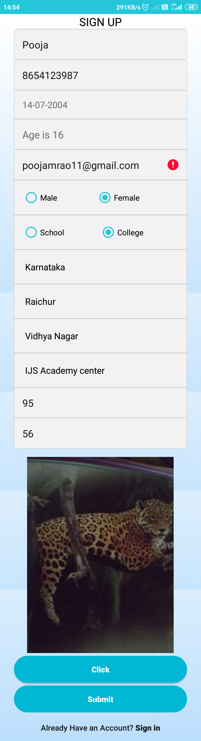
Player is not allowed to register if he is already registered with the same E-Mail ID

Slide 4
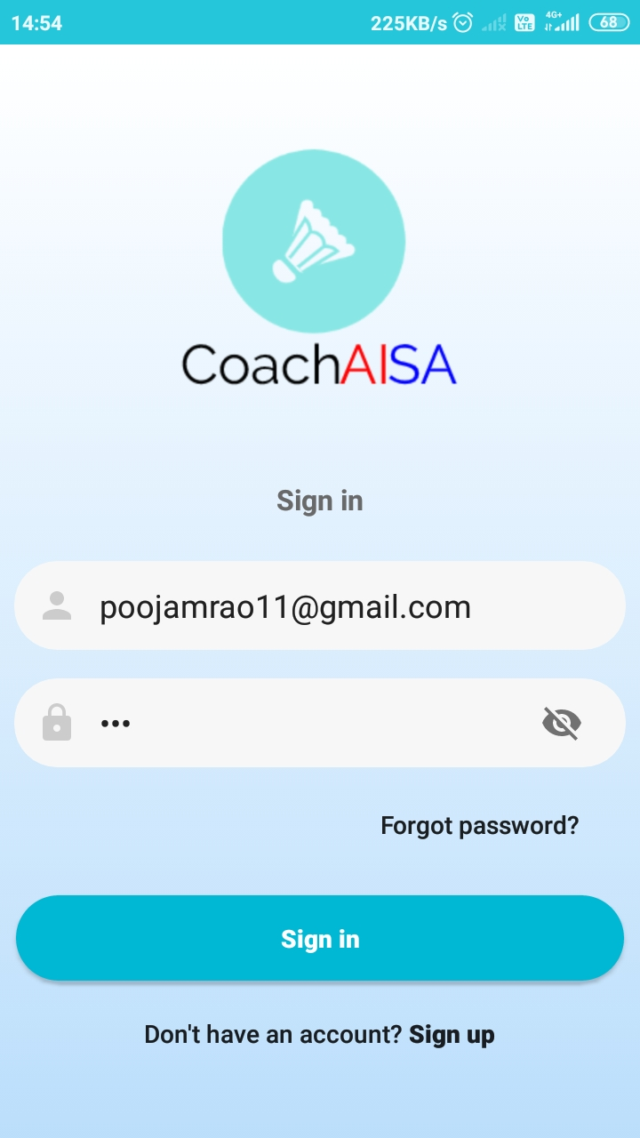
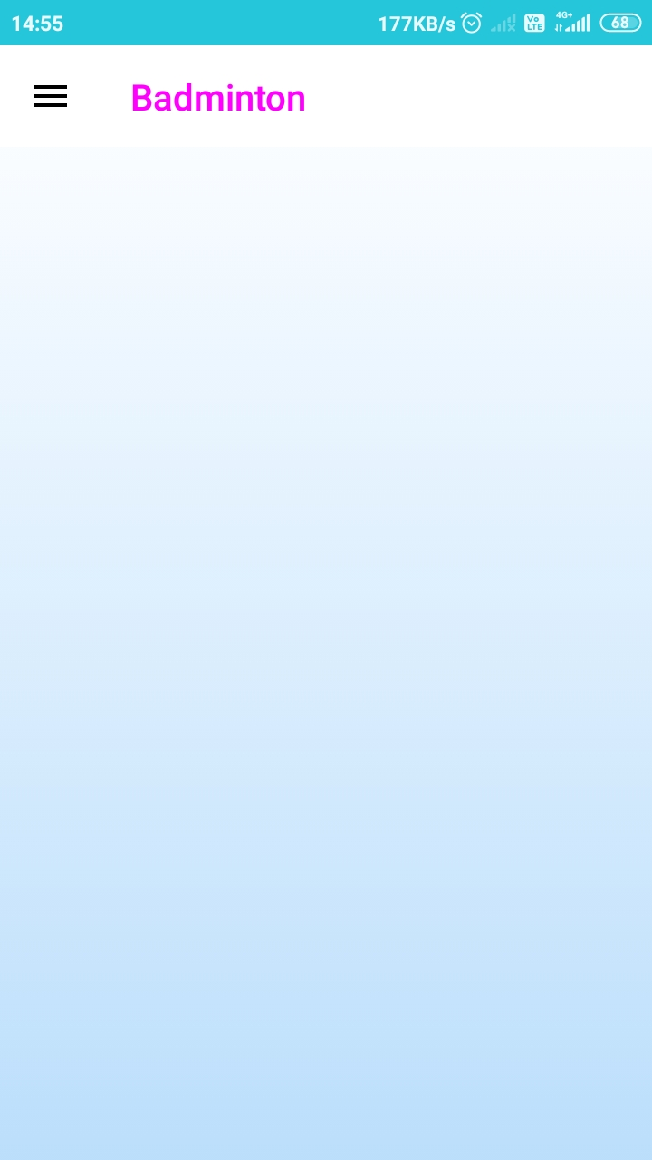
When user Enters correct login credentials /Successful Login will be landing to “Home Page”
As shown in second image.

Slide 5
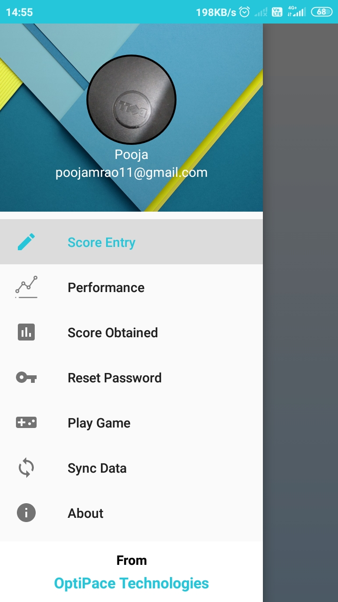
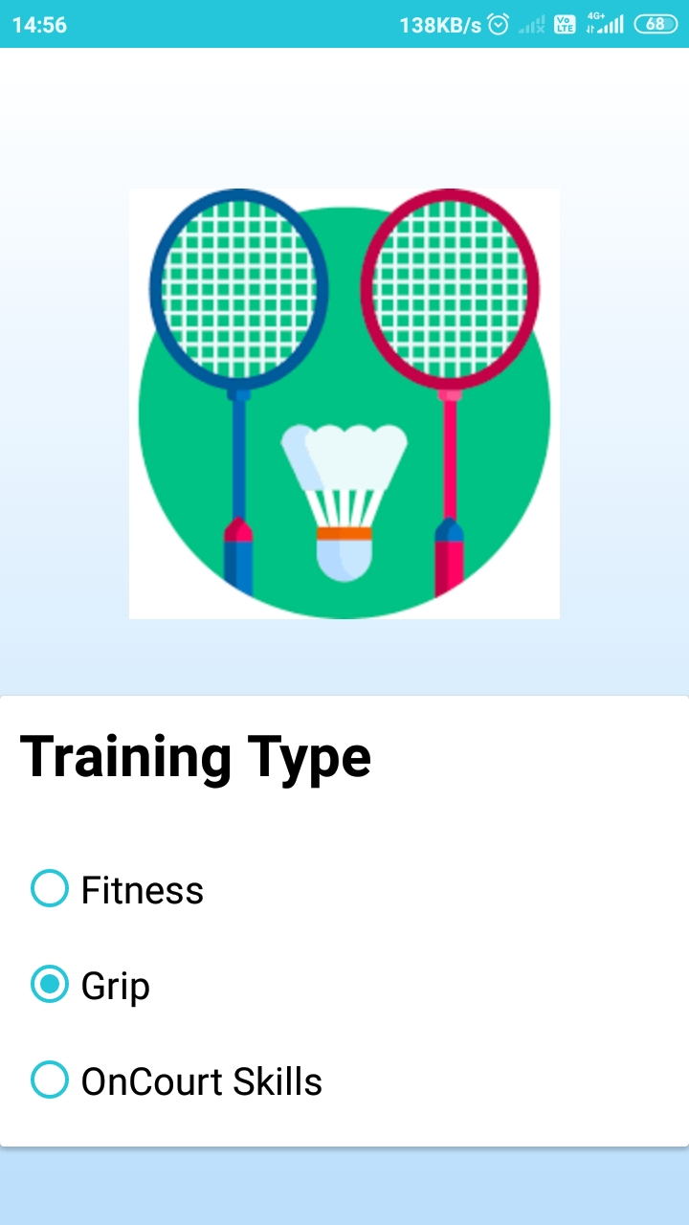
Score Entry used by user enter score based on certain category.

Slide 6
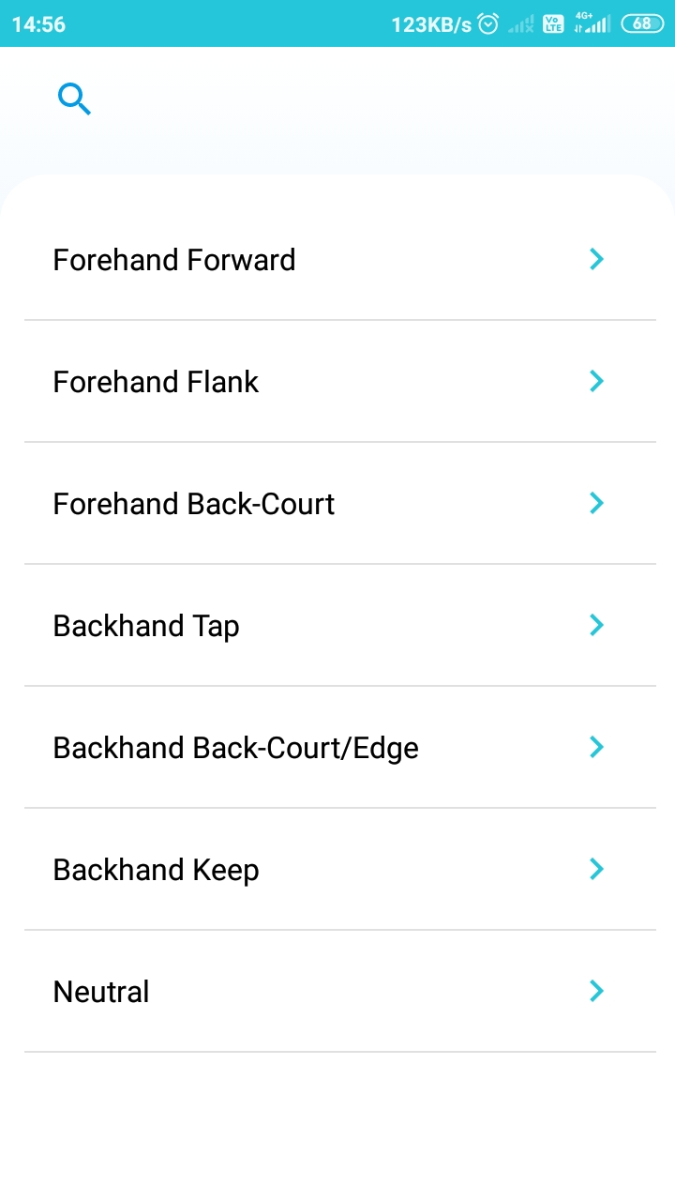
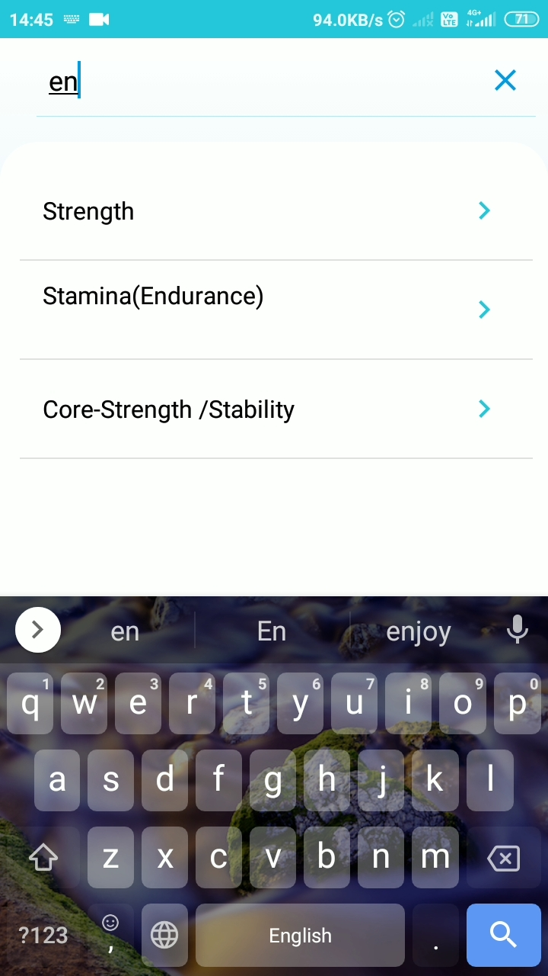
As shown in images User can search certain category type.

Slide 7
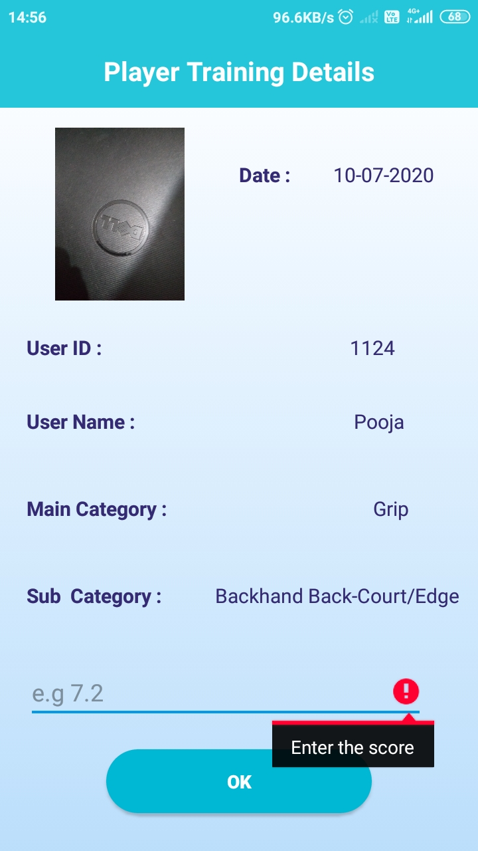
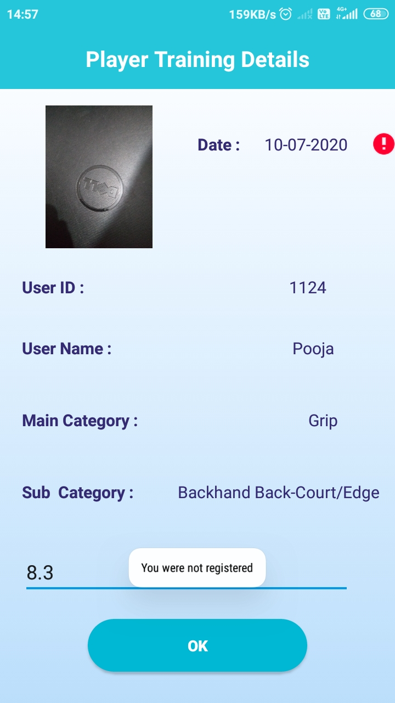
In image1 Error Icon is displayed if empty score /score is null.
In image 2 the Error Icon is displayed when user selects date which is before registration.

Slide 8

In image Error Icon is displayed when user enters upcoming days/future dates

Slide 9
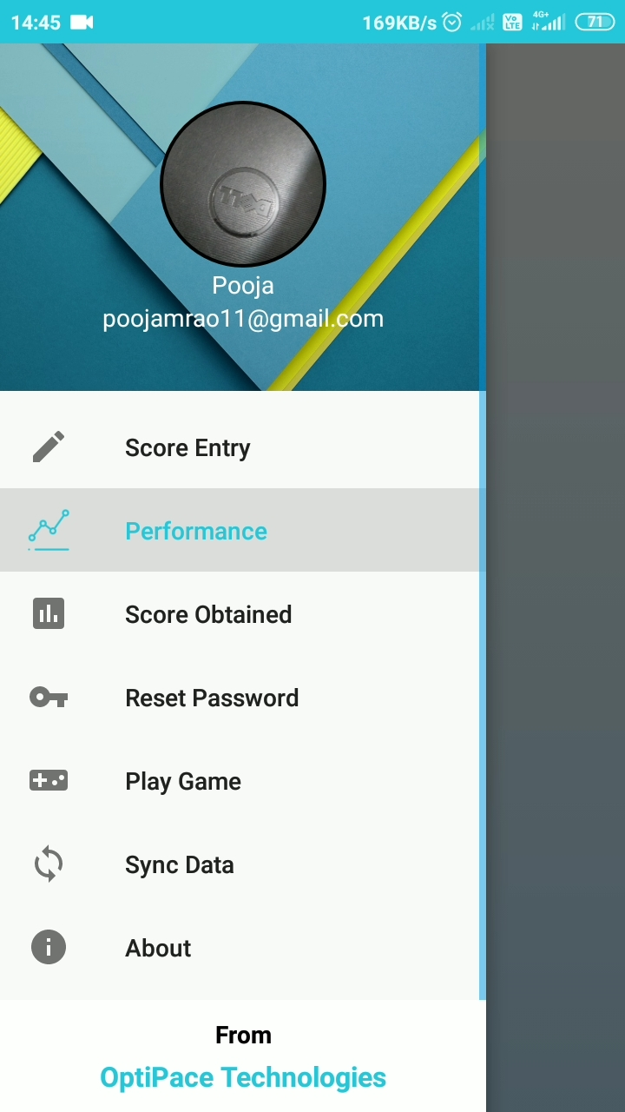
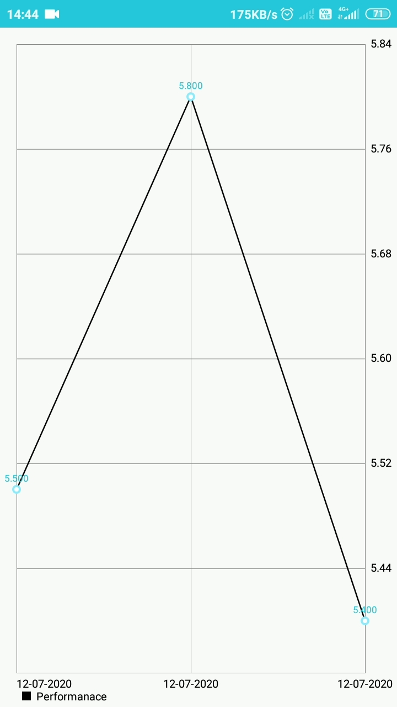
Performance
Used to display Performance in linegraph

Slide 10
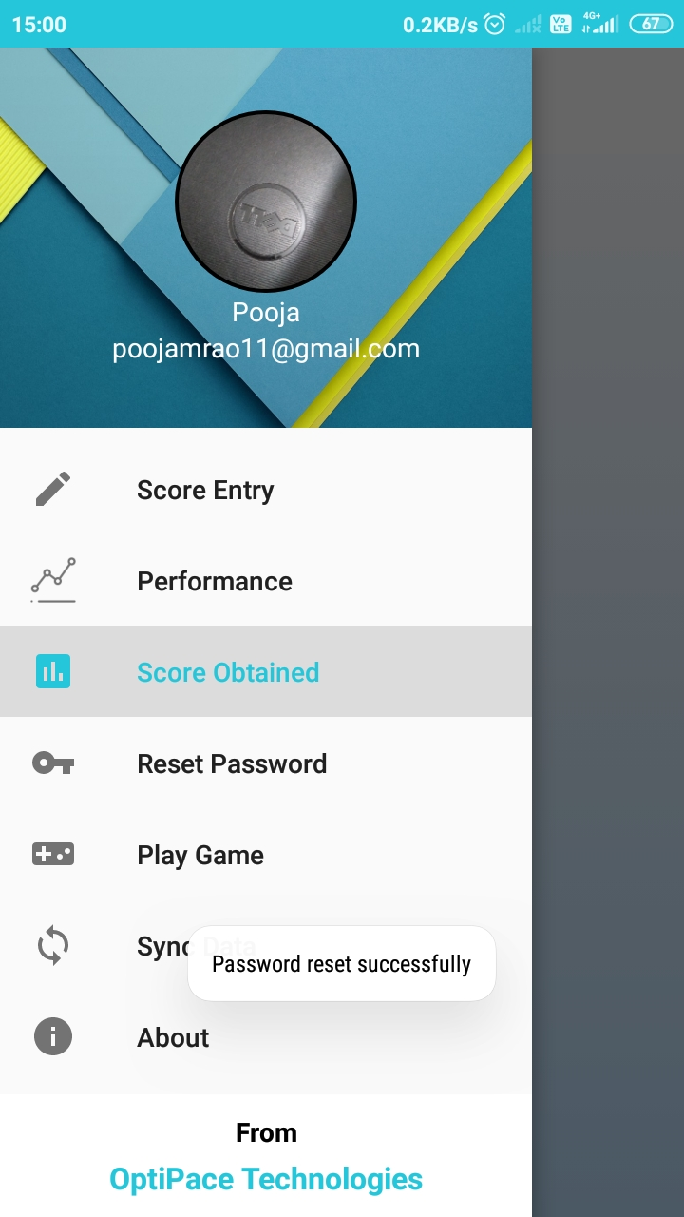
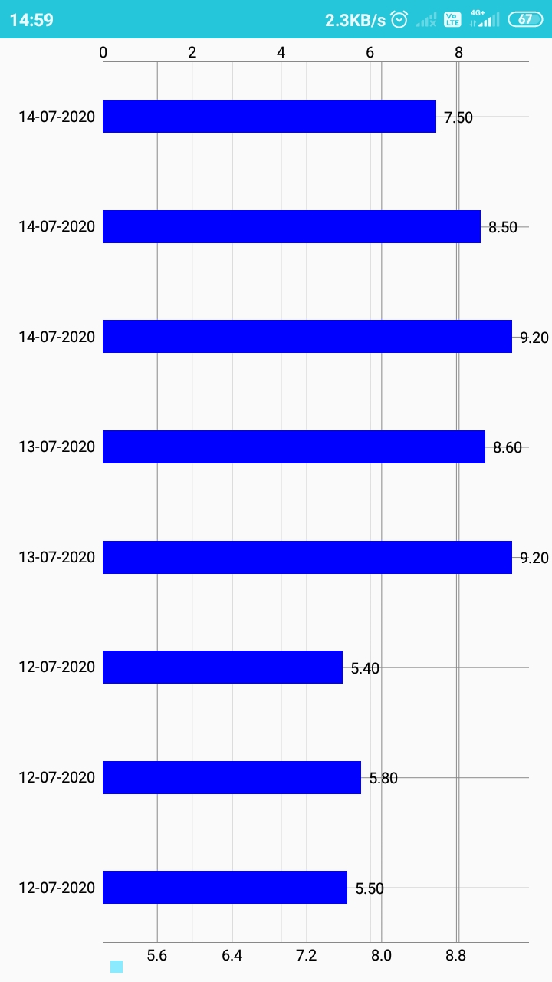
Score Obtained
Used to display Score in Bargraph

Slide 11
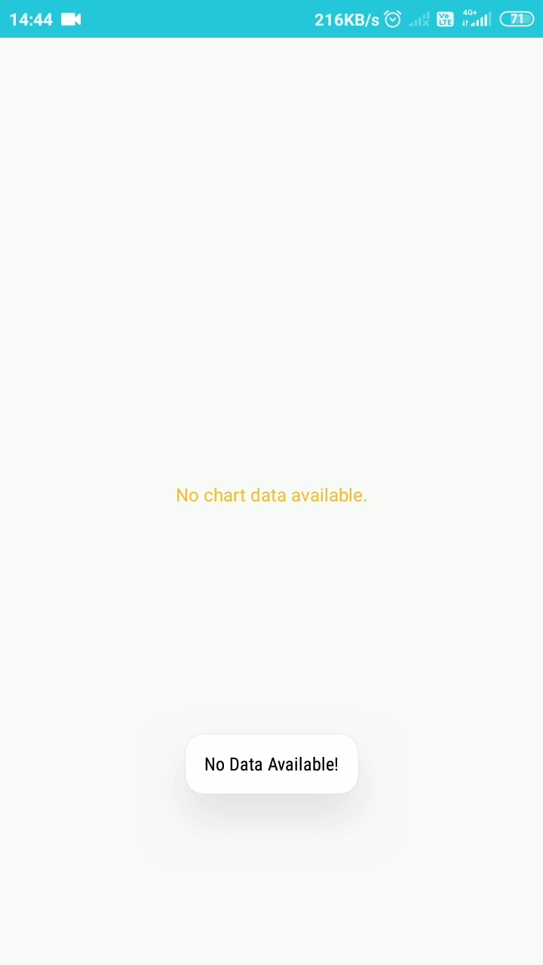
This page is displayed when No score enterd and nothing to show in graph.

Slide 12
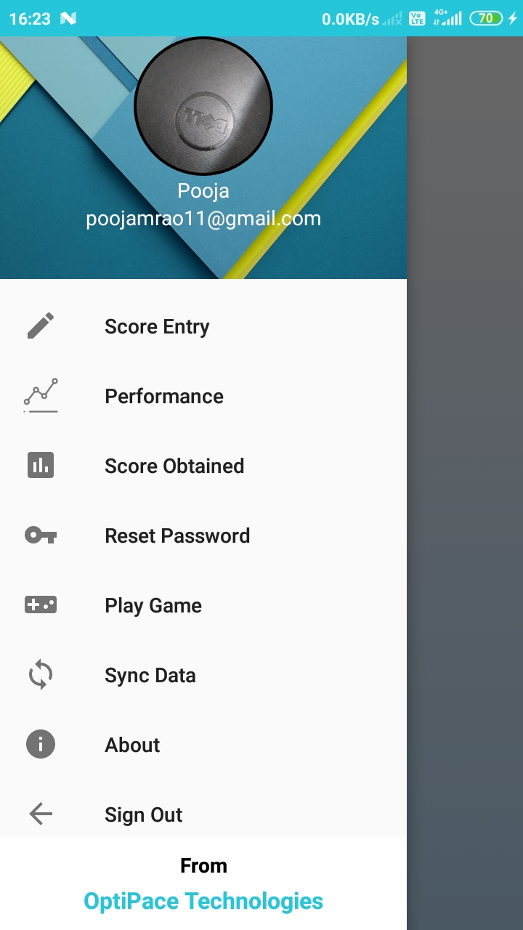
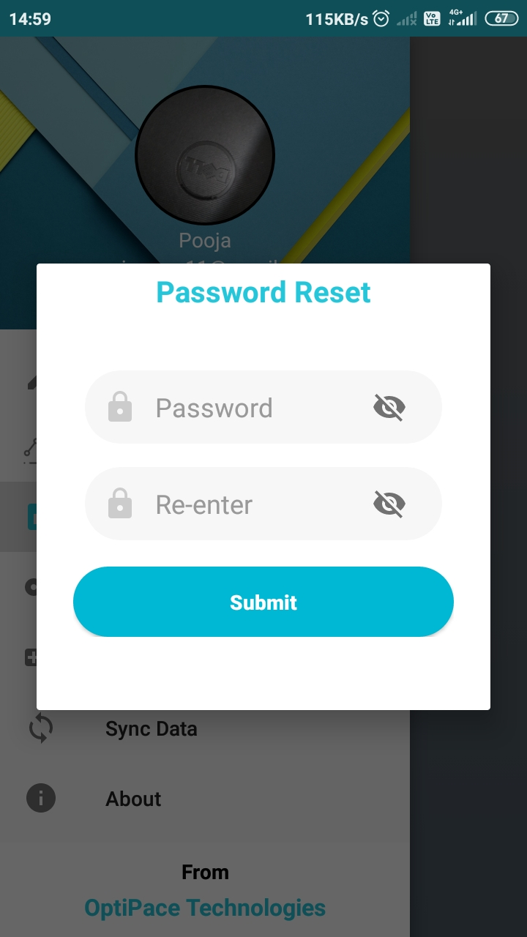
Reset Password
Used to Reset Password

Slide 13

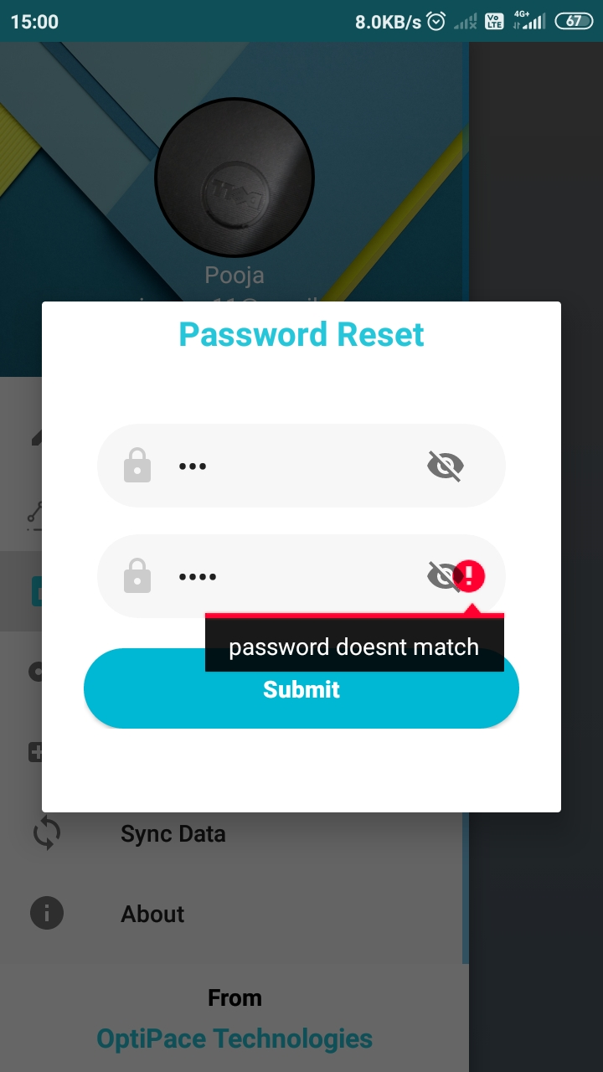
Validations for reset password

Slide 14
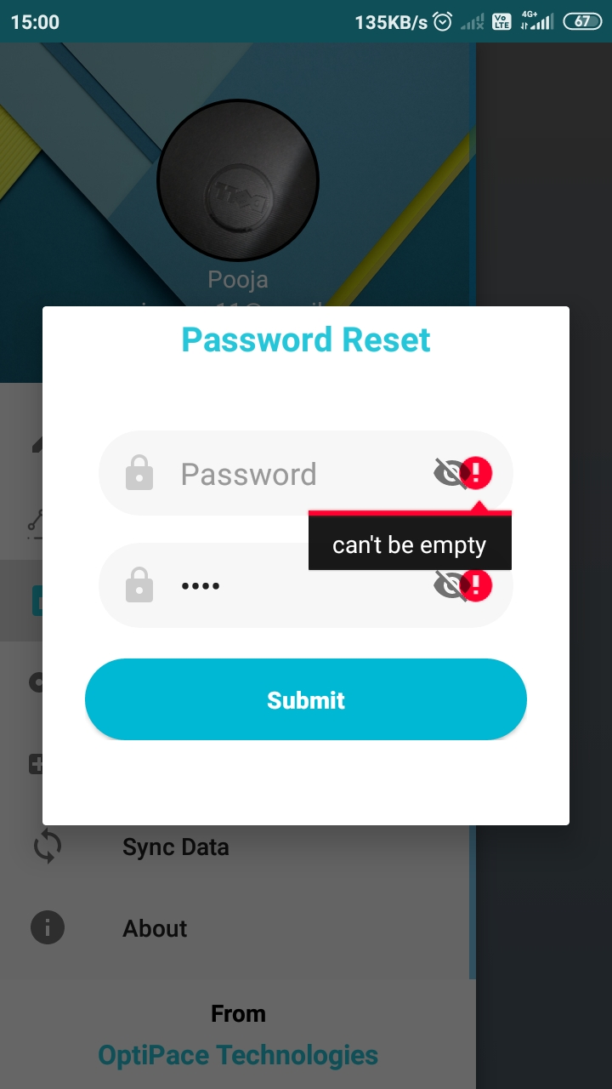
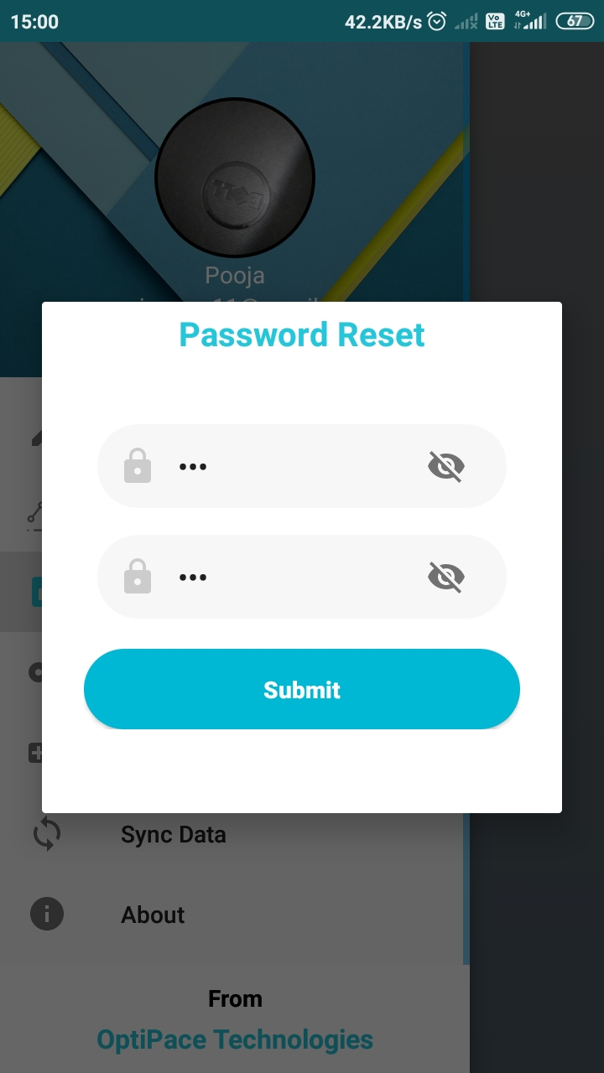
Validations for reset password

Slide 15
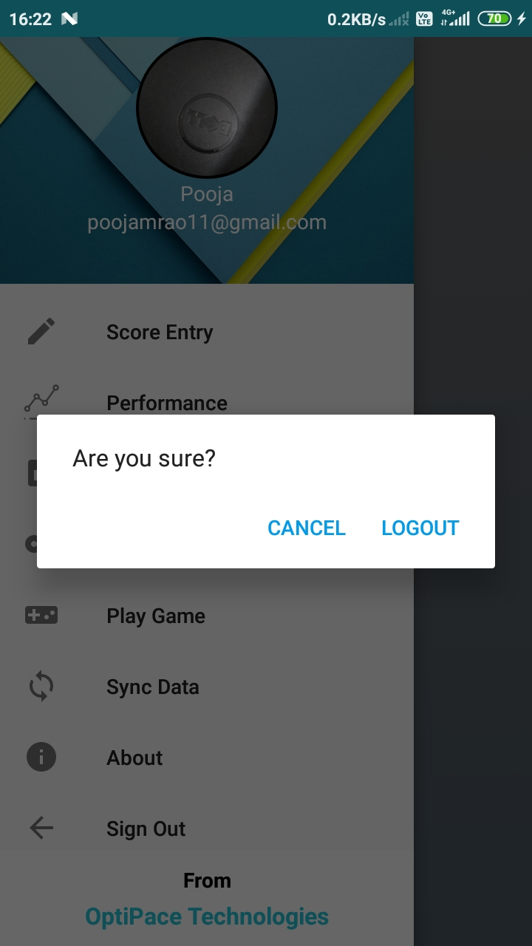
Logout
Used to logout from the app.

